Slide 1
CS 7059: Individual Project Week 12 Presentation
Lecturer: Fergal Shevlin Ph.D.
-By Luo, Kai
Student No. 15306253

Slide 2
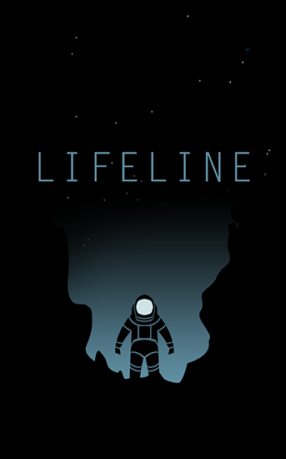
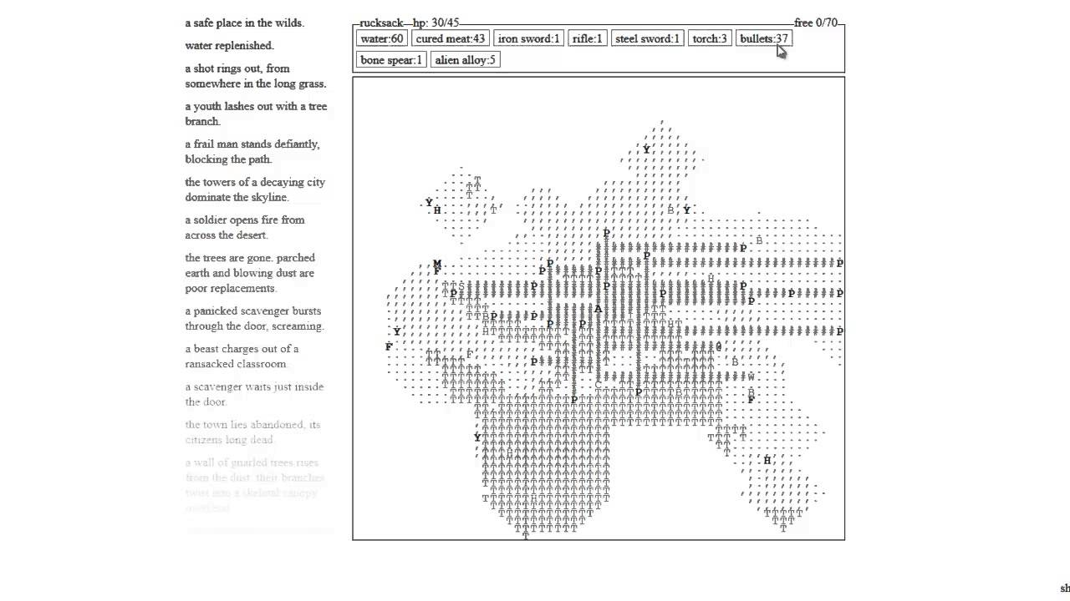
Originally
The type of game: a text-based adventure game, like the combination of Lifeline and A Dark Room.
Notes:
First I want to design a game like this, but finally I found it would cost lots of time to finish it. So I decide to make a simple game.

Slide 3
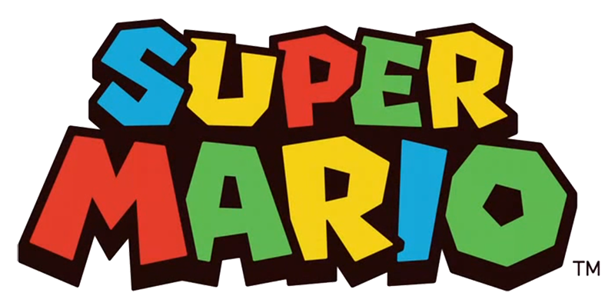
Currently
The type of game: Super Mario

Slide 4




Tools
Android Studio (Coding)
libGDX (Game Framework)
Tiled (Game map)
Github (Version Control)

Slide 5


References

Slide 6
Previous work
Week 4: Determine the type of game (Originally).
Week 7: Change to build Super Mario.
Week 8: Make the simple world of Super Mario.
Week 10: Build the Main body of the game.

Slide 7
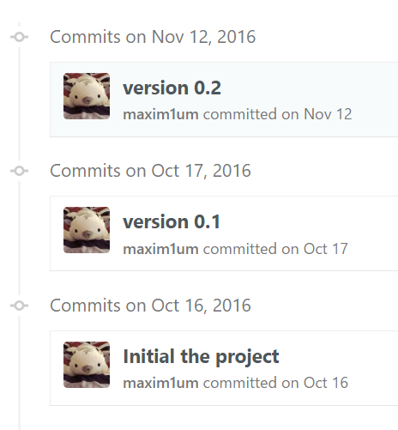
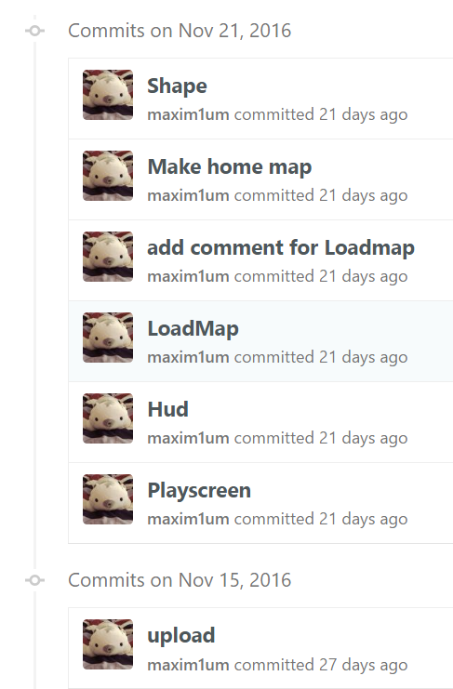
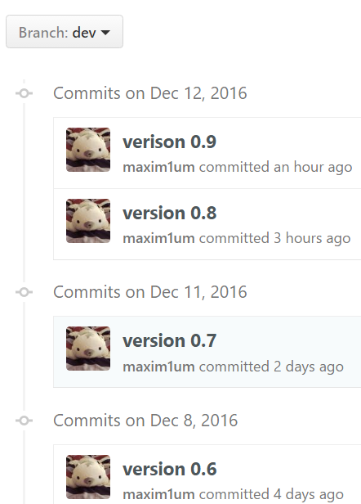
Statistic

Slide 8
Achievements
Make the level 1-1 world of Super Mario.
Nearly finish the Mario’s function.
Implement the enemy.
Make a collision detective.

Slide 9
Planning
Week 12:
Import BGM,
Adding the screen of Game Over,
Complete the function of Mario,
Change the input way (form keyboard to touch screen),
Fix the bug of Mario.

Slide 10
Question?

Slide 11
Thanks!

